Slide 1
THIS IS ME
I’m Matteo Sani, former Researcher in High Energy Physics @ University of California San Diego and CERN.
In 2017 I joined the Quantitative Group of MPS Capital Services. Since 2019 I am in charge of the “coding” part of the Financial Market Course.
Email address:
matteosan1@gmail.com

Slide 2
FINANCIAL MARKET WEBSITE
Official WebSite
https://sites.google.com/view/finmark2021
Facebook Group
https://www.facebook.com/groups/264575245517043
Lesson recording in the Moodle section of this course.

Slide 3
COURSE STRUCTURE
The course consists of about 10 lessons (Wednesday 18.00 – 20.00) in Aula Informatica 1.
The goal is to provide you with the basic numerical tools for finance and to develop a Python library with tools to solve real world problems.
Topics:
Mathematical tecniques: interpolation, bootstrapping, Monte Carlo simulation, copulas, optimization…;
Financial topics: Overnight Index Swaps, Interest Rate Swaps, Credit Derivatives, VaR, Credit Risk, CVA…;
Machine learning: basic deep learning theory, application on pricing vanilla call/put and techical analysis.

Slide 4
SUPPORTING MATERIAL
Each lesson will be presented in Jupyter Notebook format:
You will be given two version of each notebook: one completed with all the code and one without to allow you to exercise on every cell.
Additionally lecture notes will be uploaded onto the website:
More detailed explanation of the topics and additional material available;
Exercises (with solutions) at the end of each Chapter. You are STRONGLY encouraged to do them and send me by email your work:
I’ll correct your work, if necessary, and in any case give you feedback on what you have done !
For every doubt or question do not hesitate to contact me, I am always available at the e-mail addresses shown above and usually quite responsive...

Slide 5
EXAMINATION
At the end of the course you will be randomly assigned a financial project to be solved in Python. You will have to present at the exam, the Jupyter notebook with your work beside a Power Point presentation illustrating the main results:
The project has to be developed reusing the financial library that we will develop in these lessons;
Projects could be done also in groups of two (or exceptionally of three) people.
After the project presentation and the review of the involved topic/framework, few more questions on the rest of the course program will be asked.

Slide 6
HOW TO USE PYTHON
Each computer at your desks should have «Anaconda» (yes still snakes...) installed:
«Anaconda» is a Python distribution that allows you to:
Run python interactively (for quick testing of few lines of code);
Create «notebooks», a mixture of python code and explanatory text (to practice during lessons, for your homework, for your exam...).
Now I’ll show you how «Anaconda» let you run python code.
At home you can install it by going here:
https://www.anaconda.com/products/individual

Slide 7
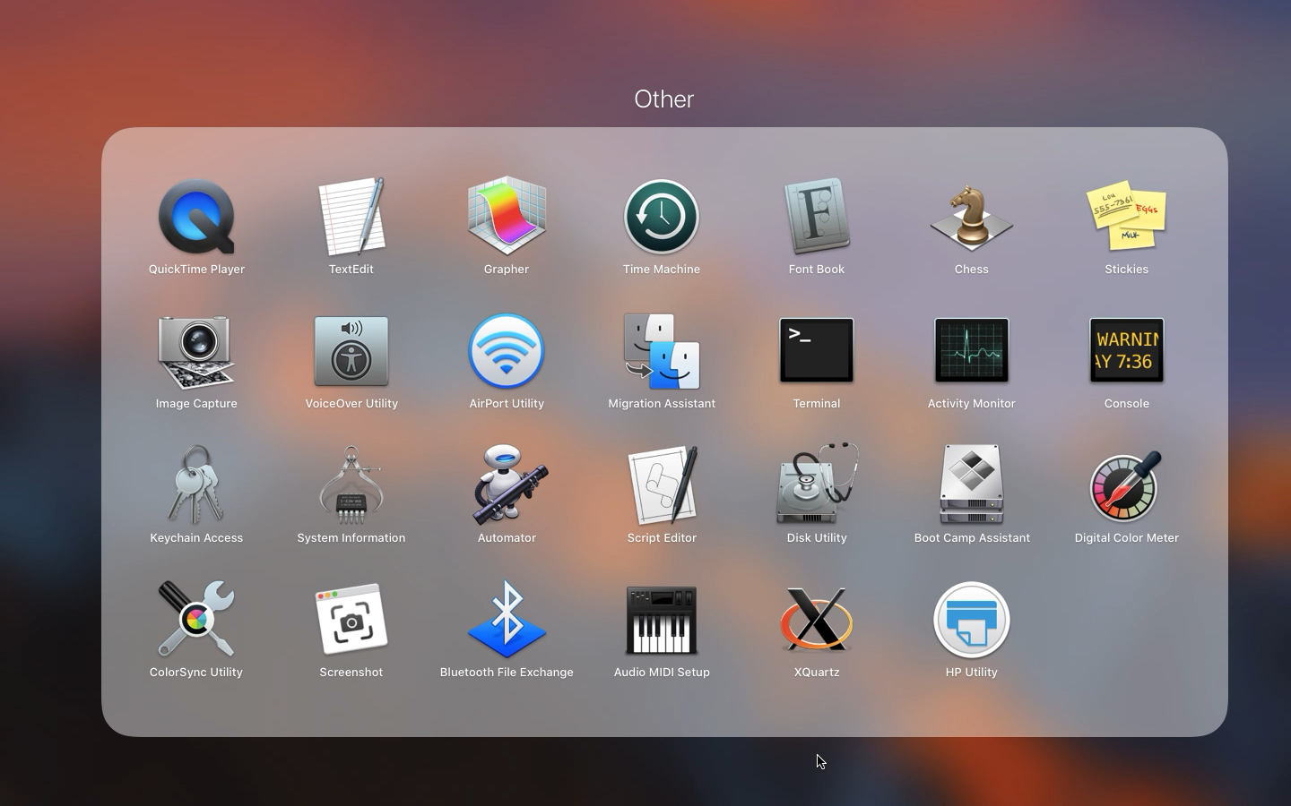
ANACONDA

Slide 8
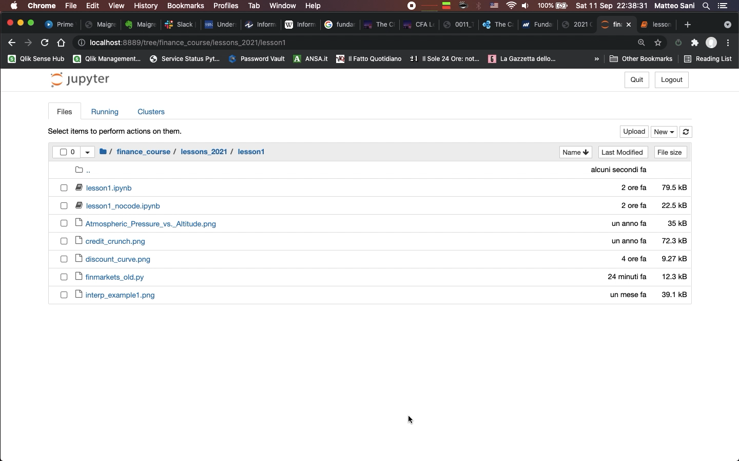
finmarkets MODULE

